Slide 1
Local Bus Route
Finder System

Slide 2
CSE411
Software Engineering & Information System Design
Instructor: Dr. Mohammad Salah Uddin
Assistant Professor
Department of CSE
East West University
Group Members: Moumita Chowdhury (2017-2-60-007)
Anika Tabassum Nizhum (2017-2-60-052)
Mahmud Jamil (2017-2-60-147)

Slide 3
Project Description
We live in a city where finding available transportation for our preferred routes can be troublesome for many people. Since people do not travel on various routes every day, it is very normal to be unfamiliar with the names of the routes' buses. Our project aims to solve the problem of finding local transportation.
For example, in Dhaka city, there are hundreds of buses. Each bus has many routes across the area. A person who lives in one area of the city can be unaware of the city's other routes or streets. They need to take public transportation, but they don't know which bus goes where. At that point, our system steps in. They would easily use our system to find out those buses goes to which routes. Simply by inputting their current location and destination, the system will inform them which bus goes to their chosen destination, as well as the shortest bus route possible. The hassle of a person would be minimized to some degree as a result of this implementation. We believe that this local bus route finder system will be beneficial to people.

Slide 4
Functional Requirements
User:
1. Users are able to login to the system.
2. Users can register in the system.
3. Users are able to search in the system for their desired information (bus or route) info.
4. Users can see the map.
5. Users will be able to see the some common routes, bus names.
6. Users can see bus details as shortcuts from the homepage.
7. Users can give their feedbacks.
Admin:
1. Admin will be able to login to the system.
2. Admin will be able to create user login for user.
3. Admin Can update the records of the system as such new bus or update route details.
4. Admin will not see the user password as an ethical issue.

Slide 5
Non-functional Requirements
Security requirement: The system should be secured. As there is log in feature where user data/password will be stored so it is important
Usability requirement: The system should be easy to use by the users, As we want more people to use the system so usability should be easy.
Reliability requirement: The system shouldn't crush. It should be working fine for all the users who search for the service.
Availability requirement: The system should be available always. As it is a city service so the system should run always.
Dependability requirement: The users are dependable to the system so the system should depend on accurate data.
Efficiency requirement: The system should be efficient to the mark. And give output in less time.
Ethical requirement: The admin should not see user sensitive data.

Slide 6
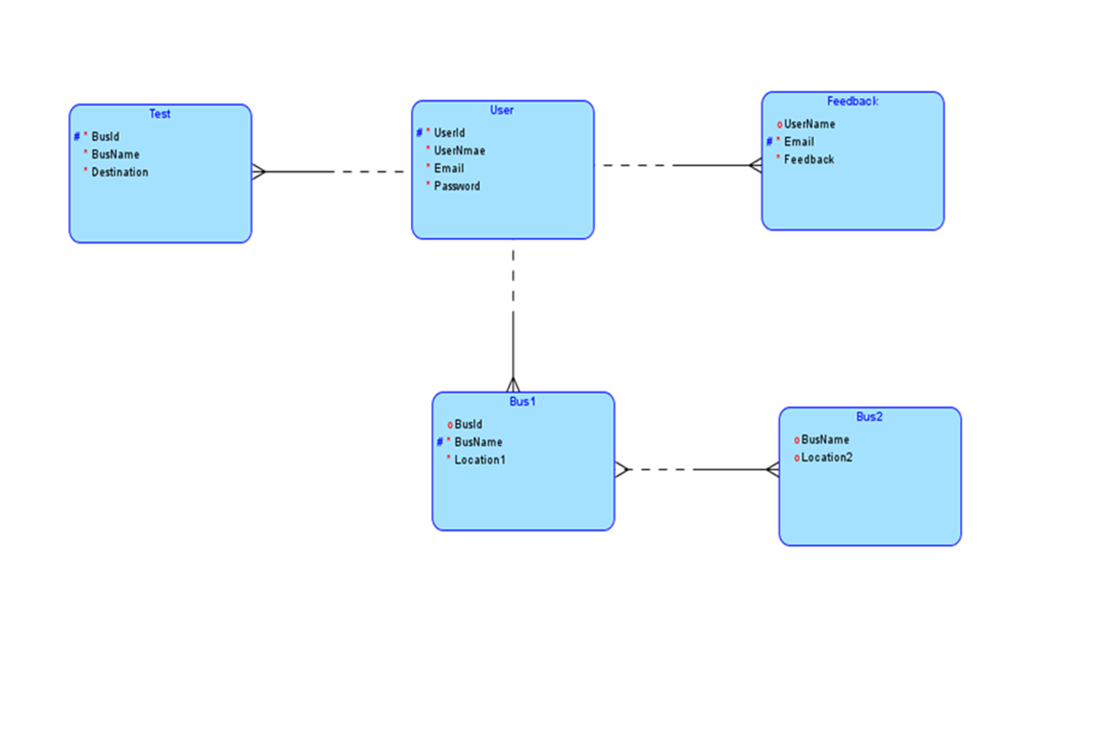
ER Diagram

Slide 7
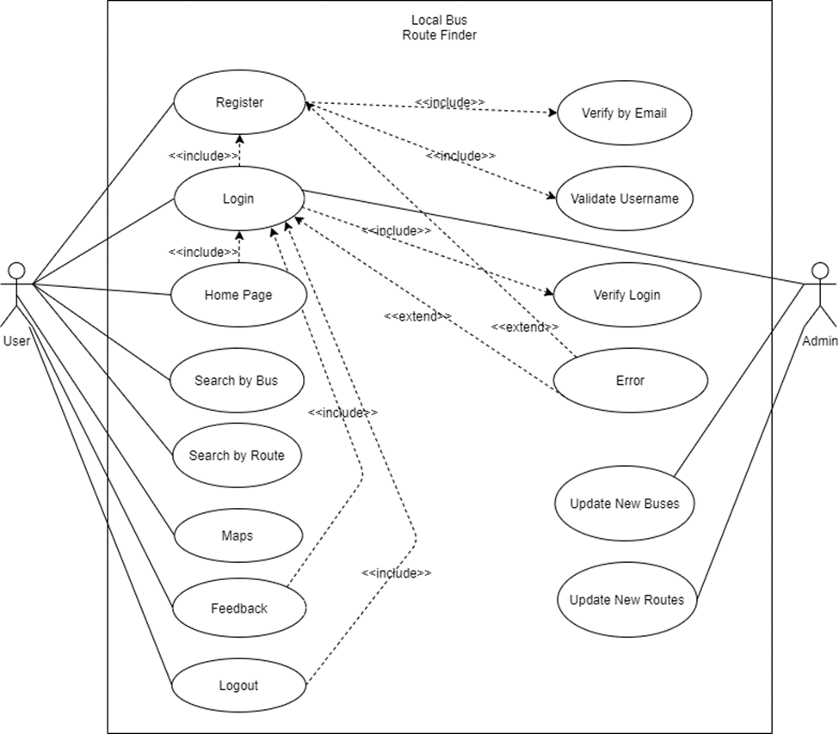
Use Case Diagram

Slide 8
Use Case Description
Usecase | Seach by route
Goal in context | This usecase helps user to search the bus names for the routes
Preconditions | User must have an account.
Success end condition | After successful searching they can able to see the bus name for the existing route they entered
Failed end condition | Try Again
Primary actor | User
Secondary actor | Admin
Trigger | Users must login first.
Description | Step | Action
 | 1 | Need to select bus routes from the existing list and click submit button.
 | 2 | Need to enter their current location and their destination and click submit button
Extensions or variations | Step | Branching Action If the current location and destination is not available in database then database show “No Bus Found Or Try again later” message

Slide 9
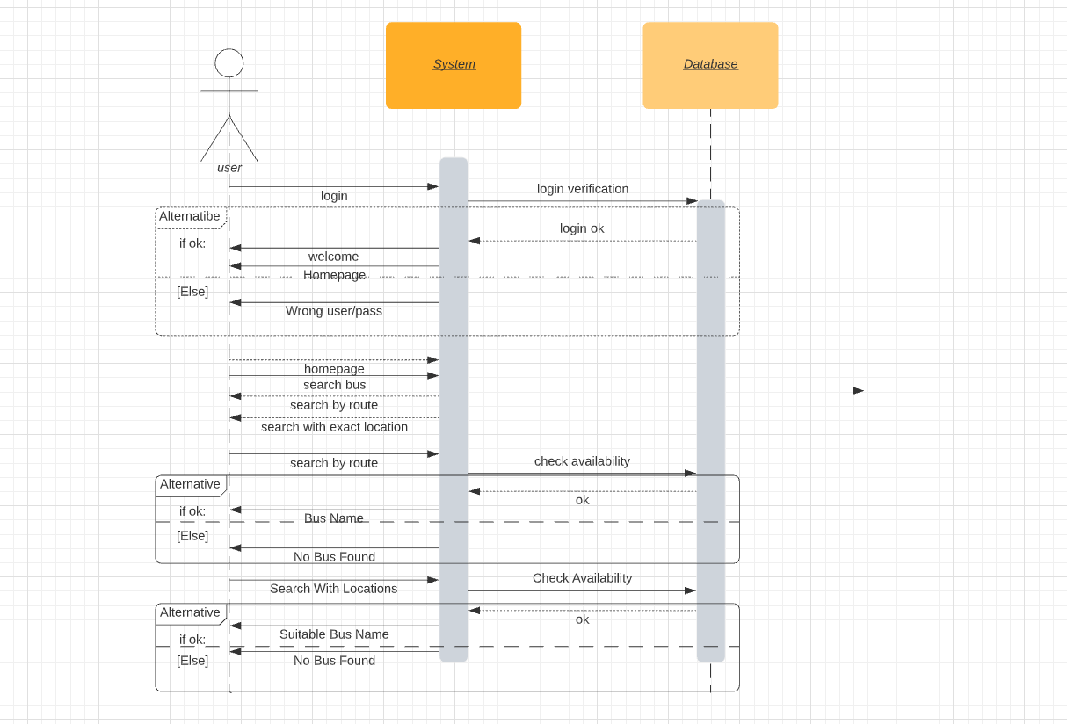
Sequence Diagram

Slide 10
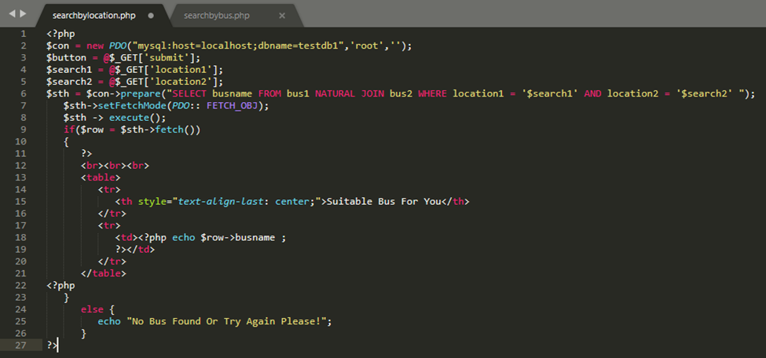
Test Code

Slide 11
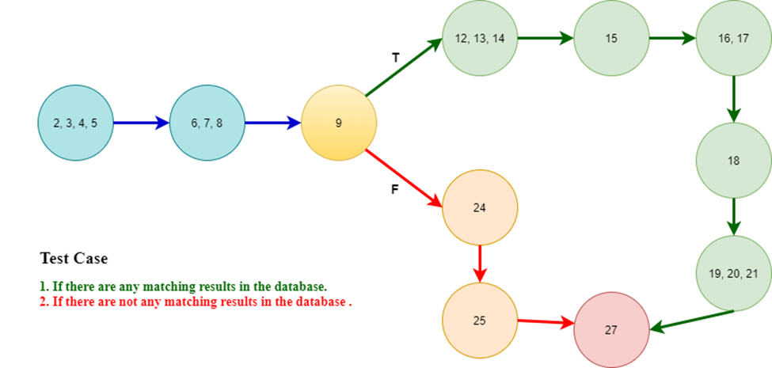
White Box Testing Solution

Slide 12
Thank You!

